Slide 1
POLICE VIOLENCE IN AMERICA
Group 39
Chika Okafor, Vasco Meerman, Matthew Parker, and David Koupaei

Slide 2
OUTLINE
Background, motivation & project scope
Methods & EDA
Models & Results Discussion
Conclusions & Next Steps

Slide 3
BACKGROUND, MOTIVATION, AND PROJECT SCOPE

Slide 4
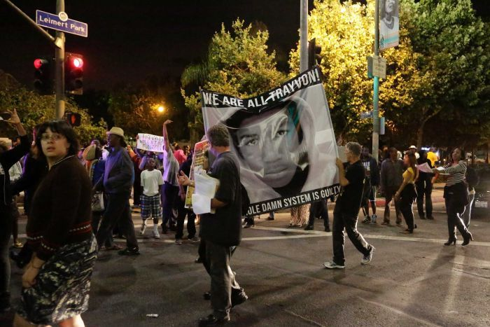
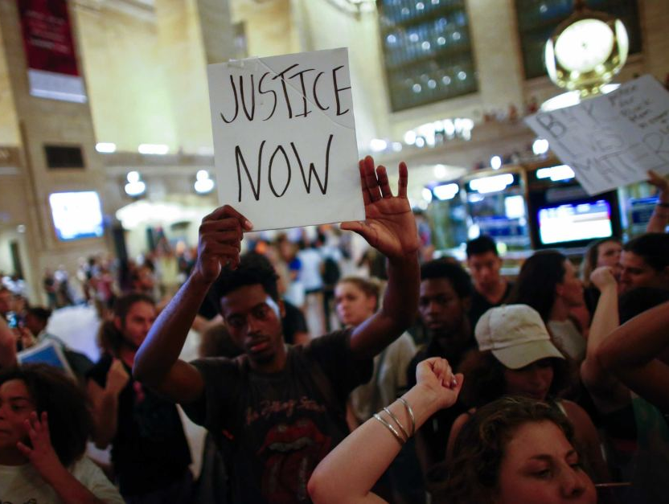
BACKGROUND & MOTIVATION
The Black Lives Matter movement started in 2013 in the US
Currently a worldwide movement
Seeking social justice
Empowering local communities inflicted by police violence

Slide 5

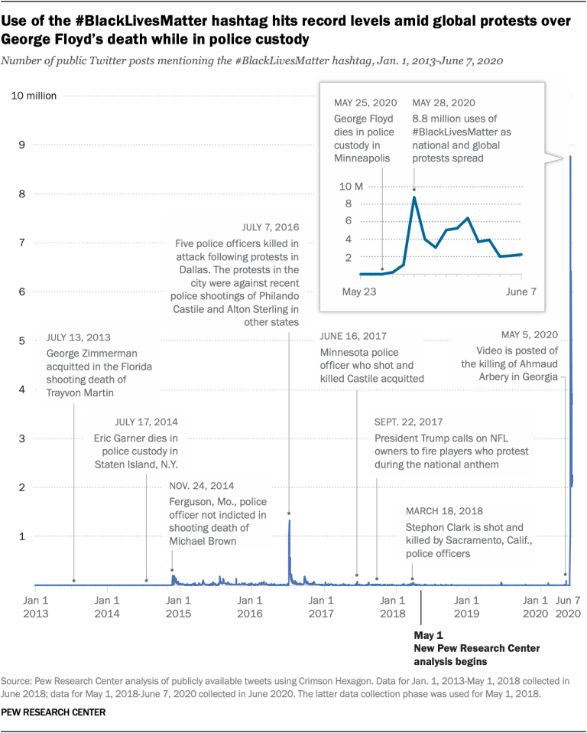
#BlackLivesMatter

Slide 6
QUESTIONS & SCOPE
Question | Why it matters?
What factors best predict whether the casualty of police violence is black? | The answer may reveal causes behind racially-biased use of police force, and uncover opportunities and solutions to improve policing.
Has the incidence rate of police violence casualties shifted across racial groups and geographic regions over the past 4-5 years? | The answer can reveal the overall impact of the Black Lives Matter movement to date, and show whether the heightened dialogue has impacted the incidence of fatal police shootings of black civilians

Slide 7
METHODS & EDA

Slide 8
DATA
The Washington Post has been tracking more than a dozen details about each police killing in the United States since 2015
We considered other data sources such as Mapping Police Violence (MPV); however, did not use for modeling due to frequent missing values and data inconsistencies
Additionally, we used external data sources to add other predictors that we thought may be useful in our models.

Slide 9
AVAILABLE RAW DATA FROM THE WASHINGTON POST
Raw Predictor | Description
DATE | Specific time of fatal police shooting incident
MANNER OF DEATH | How did the victim die? (overwhelmingly shot)
ARMED | With what type of weapon was the victim armed with
AGE | Age in years
GENDER | Male/Female classification
RACE | Racial demographic classifier
STATE | US State
SIGNS OF MENTAL ILLNESS | Did Victim show signs of mental illness [y/n]
THREAT LEVEL | Was there deemed to be a threat of violent action
FLEE | Did the victim flee the scene?
LONGITUDE/LATITUDE | Location of the incident

Slide 10
ADDITIONAL PREDICTORS FROM EXTERNAL DATA SOURCES
Predictor | Derived from | Description
Population Density | Lat/Long Location and zip code information | Number of people per square mile
Community | Population Density | Urban, Suburban, or Rural
Political Party | Voting records by state from Presidential Election | Democrat or Republican
Median Income | Lat/Long Location and zip code information | Median income of residents

Slide 11
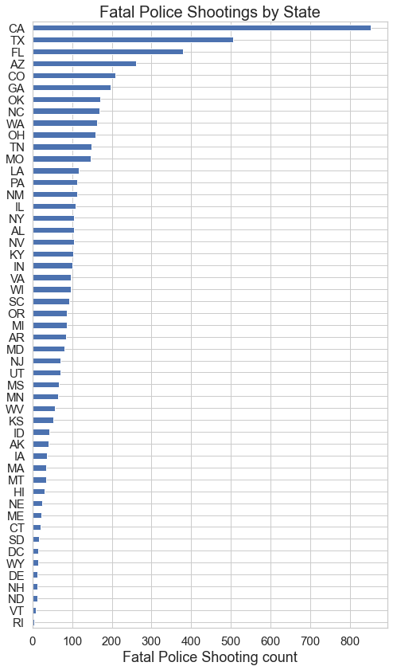
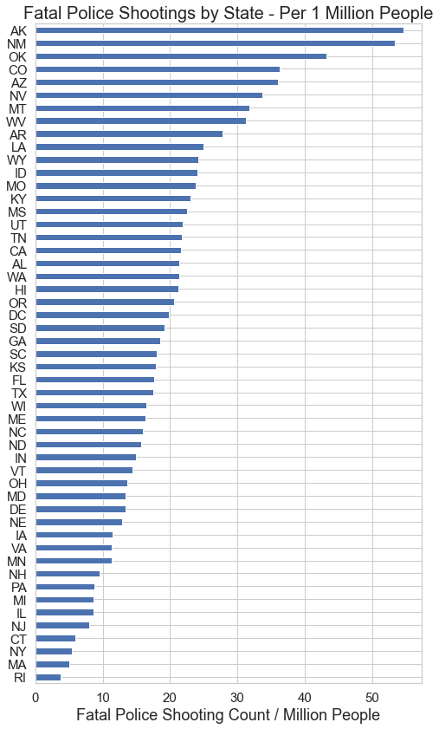
LOCATION-BASED EDA

Slide 12
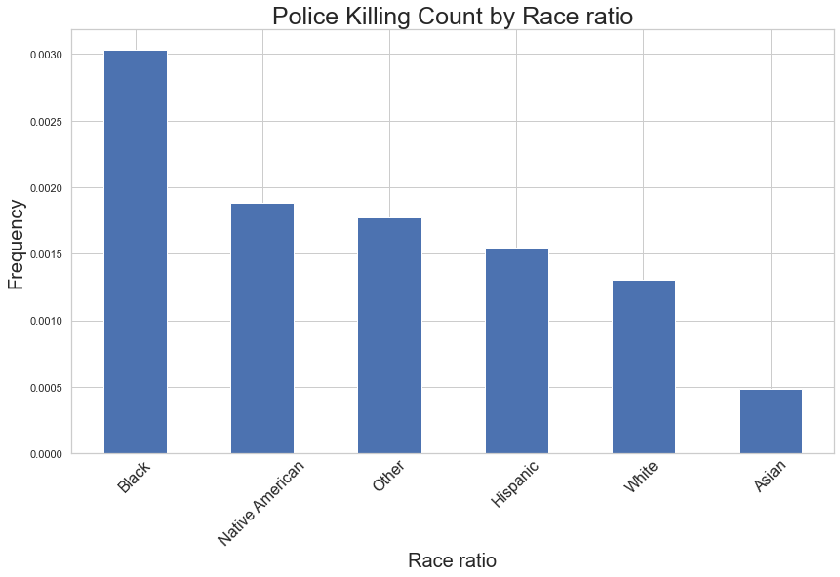
RACE-BASED EDA

Slide 13
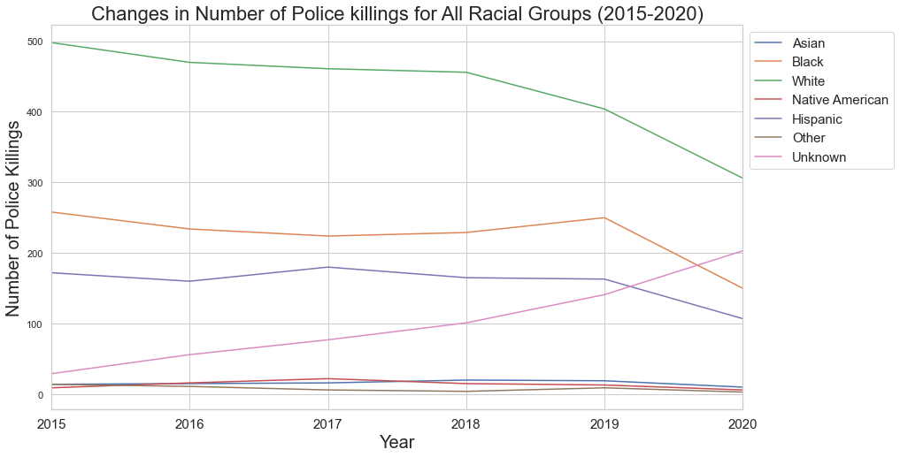
TIME-BASED EDA

Slide 14
MODELS & RESULTS

Slide 15

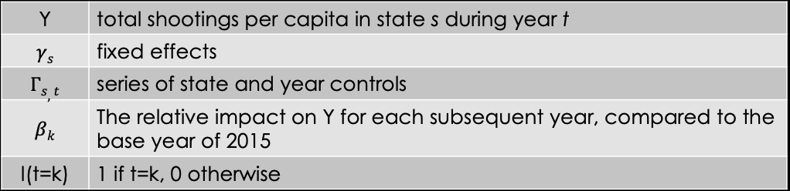
REGRESSION MODEL FOR QUESTION 1

Slide 16
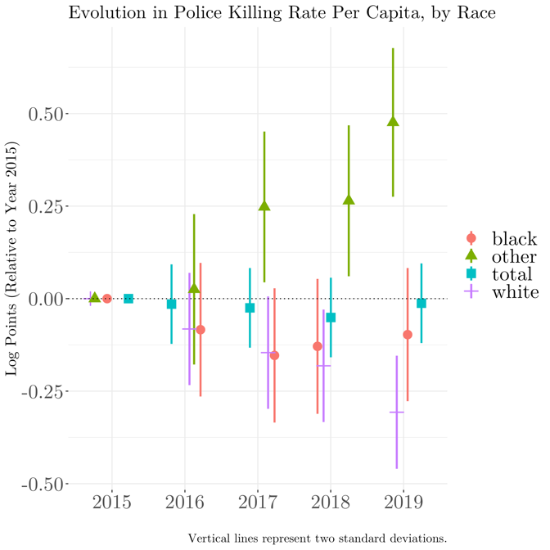
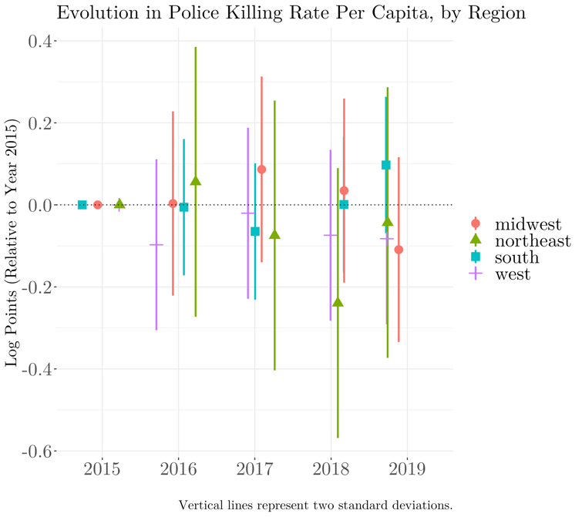
EVOLUTION IN POLICE SHOOTINGS OVER TIME

Slide 17
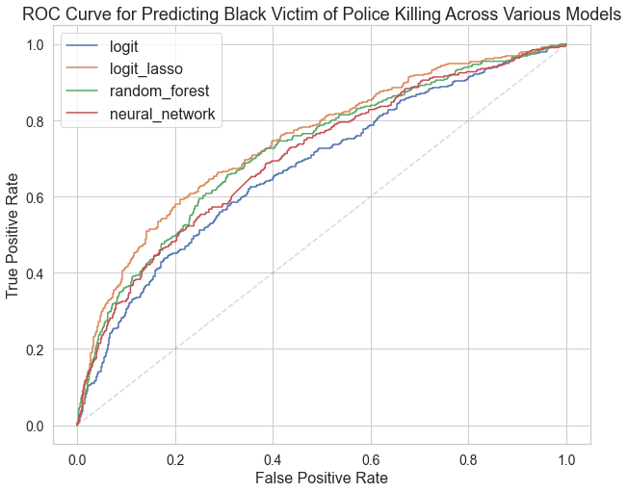
PREDICTION MODELS FOR QUESTION 2
Goal: Predict whether the victim of a fatal police shooting is an African American
Model | Train Accuracy | Test Accuracy | Area Under the ROC Curve
Logistic Regression Classifier | 79.4% | 78.0% | 0.68
Lasso-Regularized Logistic Model (C=100) | 80.3% | 78.9% | 0.75
Random Forest (Depth of 20, ‘SQRT’ Max Features) | 88.0% | 78.0% | 0.72
Neural Network (2 hidden layers with 10 nodes) | 76.0% | 75.0% | 0.72

Slide 18
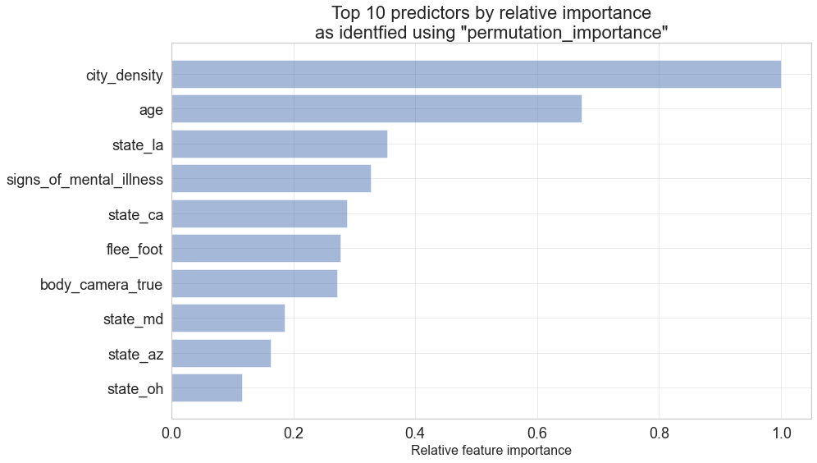

KEY PREDICTORS
Mental Illness is a better predictor than whether the suspect is armed with a gun
City Density and Age are the top two predictors
Louisiana, Maryland, California, Georgia, and Missouri are the top 5 states that differentiate racial groups in police shooting events

Slide 19
CONCLUSIONS & NEXT STEPS

Slide 20

THE SOCIAL IMPACT OF OUR FINDINGS
The importance of mental health in predicting race of a victim may reveal an implicit bias
The perceived threat level from erratic behavior may be related to racial bias.
This intersects with psychological and criminological literature on cognitive biases.
Alternative public safety responses may be appropriate if police encounters with African Americans suffering from mental health issues are more likely to escalate to fatal shootings
More expansive use of social workers and professionals trained to handle mental health situations.

Slide 21
THE SOCIAL IMPACT OF OUR FINDINGS
Despite increased public dialogue and awareness, the rate of fatal shootings of black civilians remains mostly unchanged.
The polarized response to the Black Lives Matter movement may only be garnering support from actors without real power to influence local police departments
Police departments may suffer from deep institutional barriers in modifying their interactions with black citizens
Media coverage of police shootings of unarmed black citizens are not creating sufficient political pressure for change

Slide 22
LIMITATIONS
Our data set was limited to police encounters with fatal outcomes
More data is required to explain if the disproportionate shooting of black citizens is related to:
More police interactions with black citizens
Higher likelihood for a police interaction with a black citizen to escalate to a deadly shooting

Slide 23
FUTURE WORK
Descriptive analysis on the incidence and severity of mental health crises by race, location, and time period
Additional analysis on the relative impact of mental health crises and threat levels on fatal police shootings of black civilians
More localized analysis (i.e. at the city or county level) on the prevalence of police protests and news coverage on the subsequent incidence of fatal police shootings by race

Slide 24
THANK YOU

